Slide 1



Slide 2


Intelligent Event Log Management System
PMAS-Arid Agriculture University- Rawalpindi University Institute of Information Technology
Nadeem Khan 18-ARID-2918
Shoaib Gul 18-ARID-2931
M Yasir Latif 18-ARID-2912
Supervisor : Mr. Zeeshan Javed

Slide 3
Contents
Introduction
Existing System
Problem Statement
Problem Solution
Project Scope
Project Objective
Diagrams - Use case, Class, Sequence, Component, Activity, Deployment
Tools and Technologies
Task Distribution
Screenshots
Future Project Schedule

Slide 4
Introduction
Our system is a application solution that gathers, and stores log data and
event logs .
It can capture many different types of information like logon sessions to a network and failed attempts , etc.
The system focuses on insider threat detection based on log events.
It will find normal and malicious user behavior.

Slide 5
Existing System
These are the existing systems related to our project are as follows:
The Windows Event Viewer shows a log of application and system messages, including errors, information messages, and warnings. It’s a useful tool for troubleshooting all kinds of different Windows problems.
Netwrix Event Log Manager is a free event log management software that can collect Windows event logs. It collects event logs and centrally stores them for the user to analyze. The tool allows you to monitor the event log data of multiple Windows devices from one centralized location.

Slide 6
Problem Statement
There exists different event log management system, however these are very expensive and no can afford them.
Furthermore, some of the systems are very efficient ,but have deficiencies in terms of complexity, performance and evaluation data set.
Some have relatively small test data which does not fully evaluate the performance

Slide 7
Proposed Solution
This application will help the organization to get user information based on events log.
And this application will reduce insider threat in any organization.
It will detect data as normal or malicious.
This will detect user on use of external devices , or work after hours, login activity after office hours who did not have such previous routine.

Slide 8
Project Scope
Scope of the Project :
Desk top system to detect anomalous behavior .
This will detect logon and logoff of user activity.
It will capture user performance .
It will detect user for visiting compotators websites or uploading data to other websites.

Slide 9
Project Objectives
investigative areas of poor performance
Monitoring across systems to detect particular log events and patterns in log data.
It will load data set and train to detect insider threat in any organization.
Provide an easy to use interface, both on Web and desktop.

Slide 10
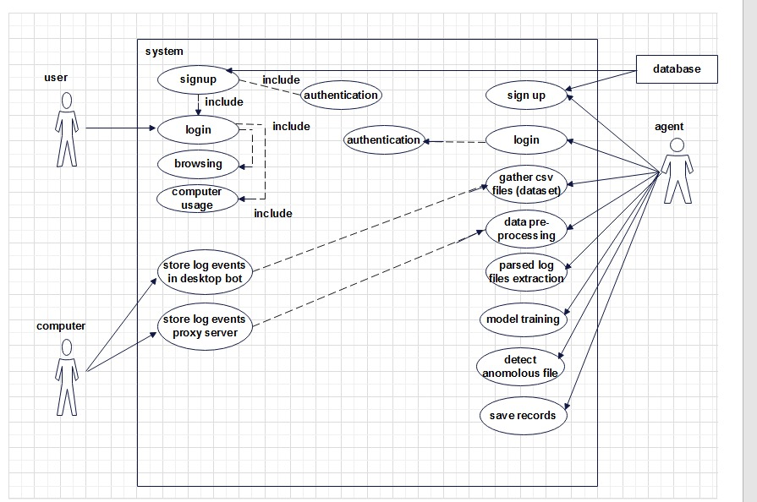
Diagrams -Use Case Diagram

Slide 11
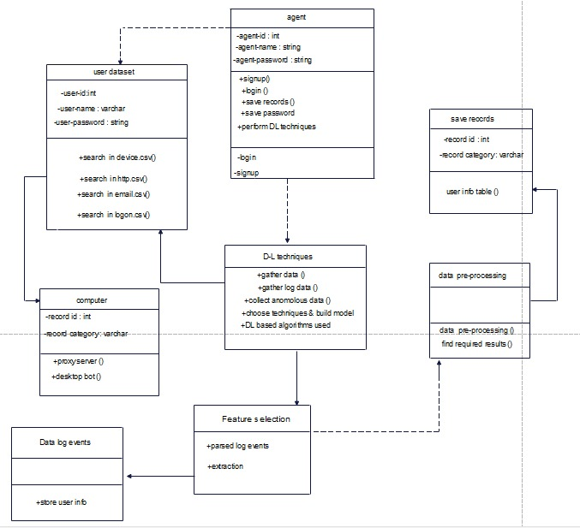
Diagrams –Class Diagram

Slide 12
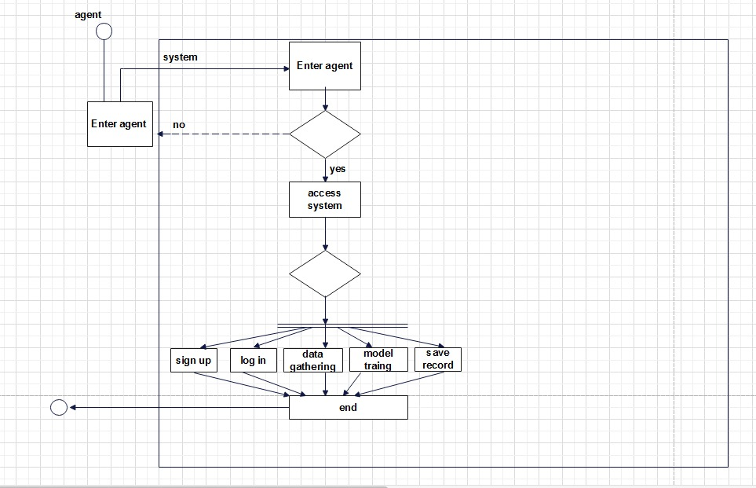
Diagrams –Activity Diagram

Slide 13
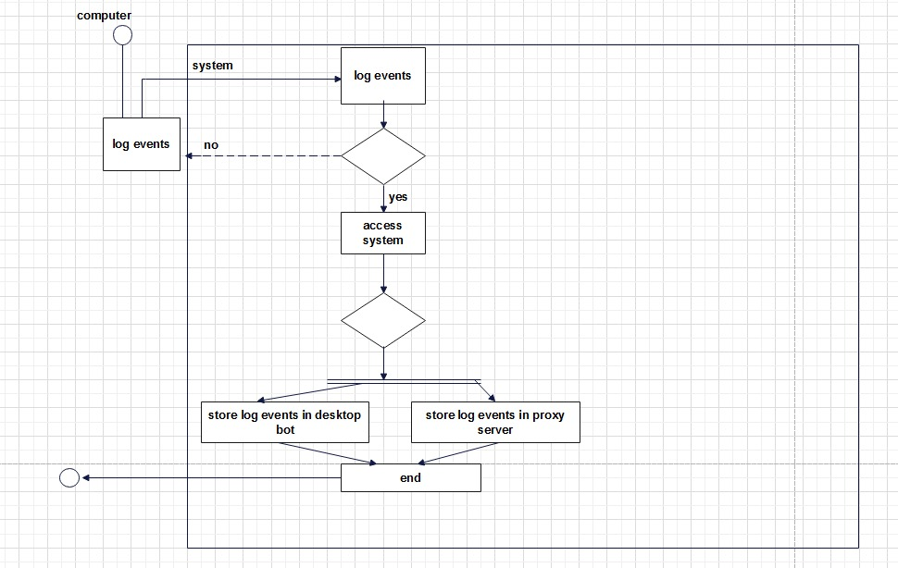
Diagrams –Activity Diagram

Slide 14
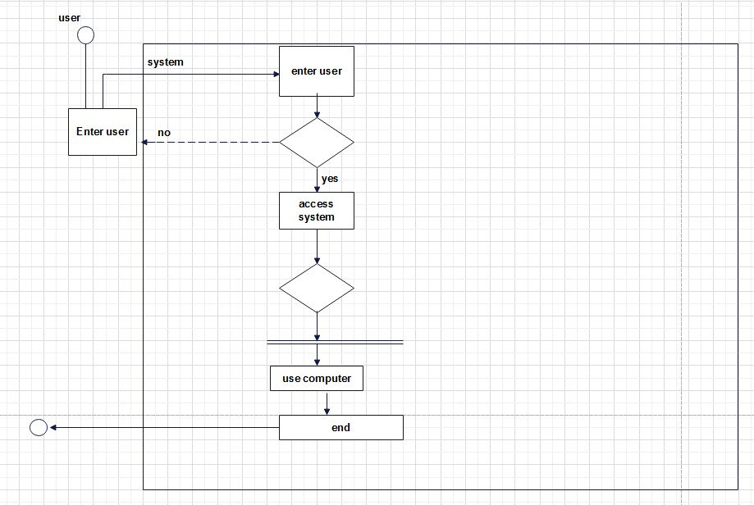
Diagrams –Activity Diagram

Slide 15
Tasks Distribution
Group Members | Responsibilities
Nadeem Khan | Creating Database, Defining Tables in Database Coding For Home Page Documentation Database connectivity Extracting Event log
Shoaib Gul | Sign Up page Documentation Display Data Set in table Displaying Event log Read Event Log
M Yasir Latif | Login Page Poster Documentation diagrams Presentation

Slide 16




Tools & Technologies

Slide 17
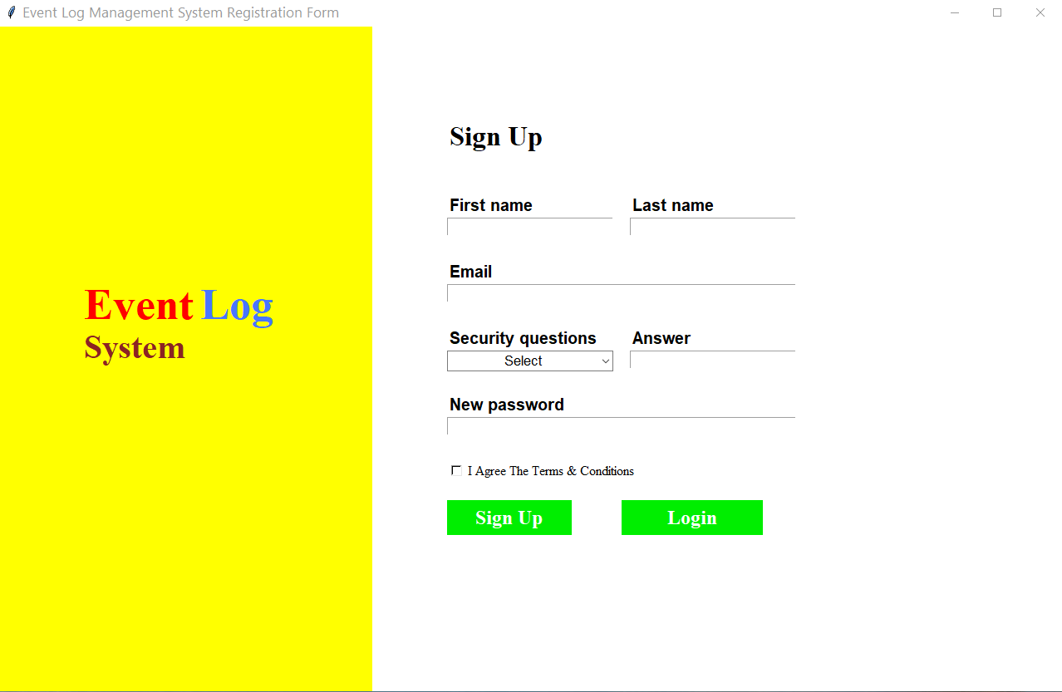
SignUp

Slide 18
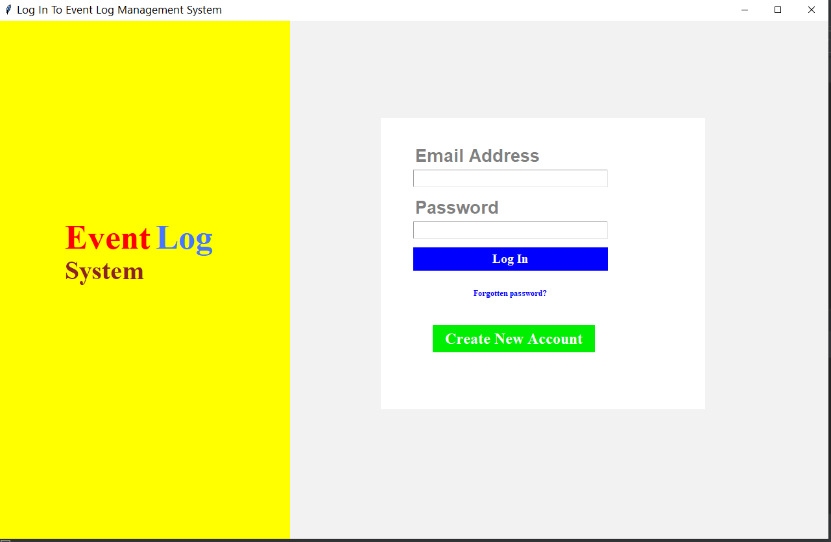
LoginPage

Slide 19
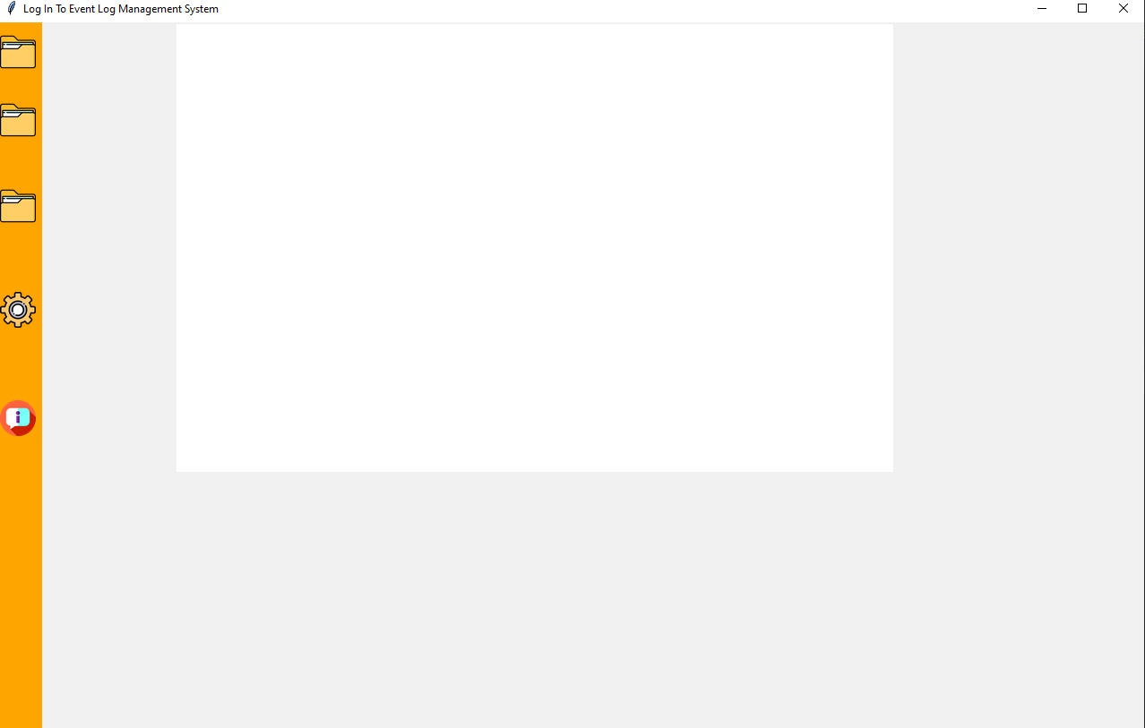

Slide 20
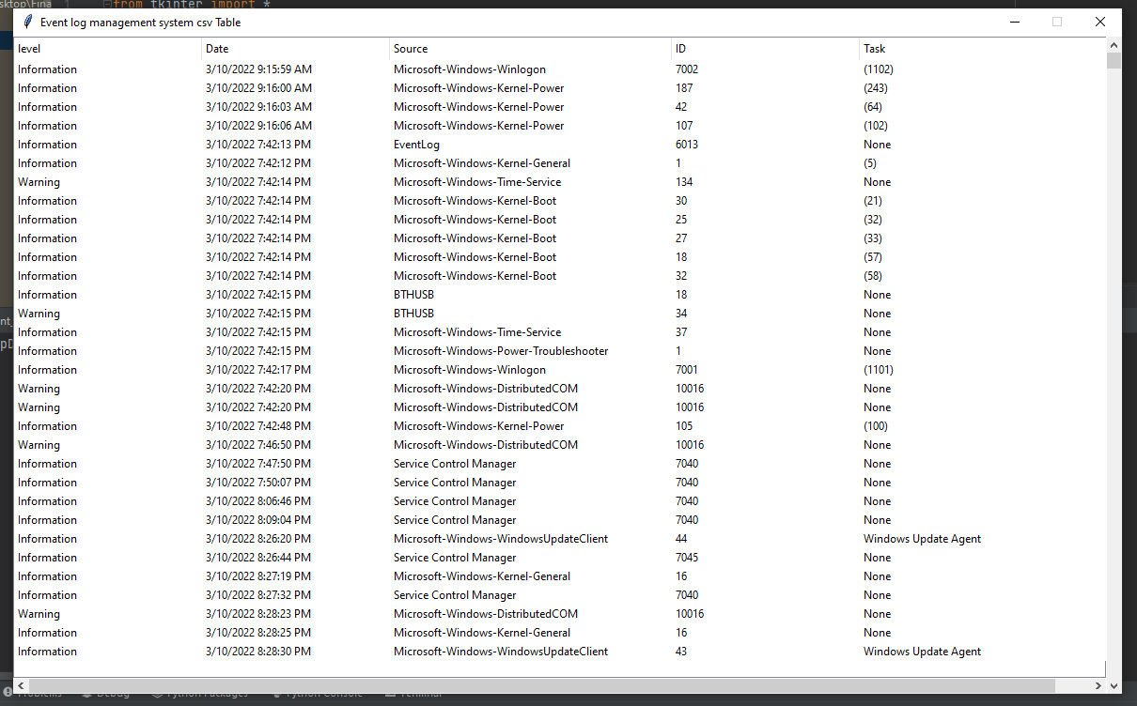

Slide 21
Future Project Schedule
Tasks | Schedule
Design & Coding of Project Loading Data Set Manage Data Train model | 10th February To 30th March 2022
Creating Reports | 1st April to 20th April 2022
Testing of Project Module wise & Finishing the Code | 21st April To 30th April 2022
Integrating Project | 1st May 2022 To 20th May 2022
Testing of Project | 21st May To Finish Date

Slide 22


